Slide 1
Chapter 7 Single-Dimensional Arrays

Slide 2
Opening Problem
Read one hundred numbers, compute their average, and find out how many numbers are above the average.

Slide 3
Objectives
To describe why arrays are necessary in programming (§7.1).
To declare array reference variables and create arrays (§§7.2.1–7.2.2).
To obtain array size using arrayRefVar.length and know default values in an array (§7.2.3).
To access array elements using indexes (§7.2.4).
To declare, create, and initialize an array using an array initializer (§7.2.5).
To program common array operations (displaying arrays, summing all elements, finding the minimum and maximum elements, random shuffling, and shifting elements) (§7.2.6).
To simplify programming using the foreach loops (§7.2.7).
To apply arrays in application development (AnalyzeNumbers, DeckOfCards) (§§7.3–7.4).
To copy contents from one array to another (§7.5).
To develop and invoke methods with array arguments and return values (§§7.6–7.8).
To define a method with a variable-length argument list (§7.9).
To search elements using the linear (§7.10.1) or binary (§7.10.2) search algorithm.
To sort an array using the selection sort approach (§7.11).
To use the methods in the java.util.Arrays class (§7.12).
To pass arguments to the main method from the command line (§7.13).

Slide 4
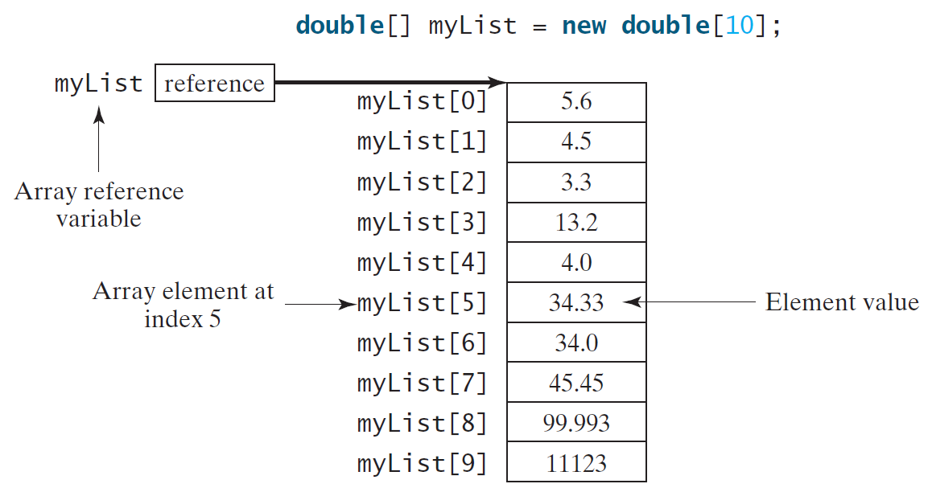
Introducing Arrays
Array is a data structure that represents a collection of the same types of data.

Slide 5
Declaring Array Variables
datatype[] arrayRefVar;
Example:
double[] myList;
datatype arrayRefVar[]; // This style is allowed, but not preferred
Example:
double myList[];

Slide 6
Creating Arrays
arrayRefVar = new datatype[arraySize];
Example:
myList = new double[10];
myList[0] references the first element in the array.
myList[9] references the last element in the array.

Slide 7
Declaring and Creating in One Step
datatype[] arrayRefVar = new datatype[arraySize];
double[] myList = new double[10];
datatype arrayRefVar[] = new datatype[arraySize];
double myList[] = new double[10];

Slide 8
The Length of an Array
Once an array is created, its size is fixed.
It cannot be changed.
You can find its size using
arrayRefVar.length
For example,
myList.length returns 10

Slide 9
Default Values
When an array is created, its elements are assigned the default value of
0 for the numeric primitive data types,
'\u0000' for char types, and
false for boolean types.

Slide 10
Indexed Variables
The array elements are accessed through the index.
The array indices are 0-based, i.e., it starts from 0 to arrayRefVar.length-1.
In the example in Figure 6.1, myList holds ten double values and the indices are from 0 to 9.
Each element in the array is represented using the following syntax, known as an indexed variable:
arrayRefVar[index];

Slide 11
Using Indexed Variables
After an array is created, an indexed variable can be used in the same way as a regular variable.
For example, the following code adds the value in myList[0] and myList[1] to myList[2].
myList[2] = myList[0] + myList[1];

Slide 12
Array Initializers
Declaring, creating, initializing in one step:
double[] myList = {1.9, 2.9, 3.4, 3.5};
This shorthand syntax must be in one statement.

Slide 13
Declaring, creating, initializing using the Shorthand Notation
double[] myList = {1.9, 2.9, 3.4, 3.5};
This shorthand notation is equivalent to the following statements:
double[] myList = new double[4];
myList[0] = 1.9;
myList[1] = 2.9;
myList[2] = 3.4;
myList[3] = 3.5;

Slide 14
CAUTION
Using the shorthand notation, you have to declare, create, and initialize the array all in one statement. Splitting it would cause a syntax error. For example, the following is wrong:
double[] myList;
myList = {1.9, 2.9, 3.4, 3.5};

Slide 15
Trace Program with Arrays
animation
Declare array variable values, create an array, and assign its reference to values
public class Test {
public static void main(String[] args) {
int[] values = new int[5];
for (int i = 1; i < 5; i++) {
values[i] = i + values[i-1];
}
values[0] = values[1] + values[4];
}
}

Slide 16
Trace Program with Arrays
animation
i becomes 1
public class Test {
public static void main(String[] args) {
int[] values = new int[5];
for (int i = 1; i < 5; i++) {
values[i] = i + values[i-1];
}
values[0] = values[1] + values[4];
}
}

Slide 17
Trace Program with Arrays
animation
i (=1) is less than 5
public class Test {
public static void main(String[] args) {
int[] values = new int[5];
for (int i = 1; i < 5; i++) {
values[i] = i + values[i-1];
}
values[0] = values[1] + values[4];
}
}

Slide 18
Trace Program with Arrays
animation
After this line is executed, value[1] is 1
public class Test {
public static void main(String[] args) {
int[] values = new int[5];
for (int i = 1; i < 5; i++) {
values[i] = i + values[i-1];
}
values[0] = values[1] + values[4];
}
}

Slide 19
Trace Program with Arrays
animation
After i++, i becomes 2
public class Test {
public static void main(String[] args) {
int[] values = new int[5];
for (int i = 1; i < 5; i++) {
values[i] = i + values[i-1];
}
values[0] = values[1] + values[4];
}
}

Slide 20
Trace Program with Arrays
animation
i (= 2) is less than 5
public class Test {
public static void main(String[] args) {
int[] values = new int[5];
for (int i = 1; i < 5; i++) {
values[i] = i + values[i-1];
}
values[0] = values[1] + values[4];
}
}

Slide 21
Trace Program with Arrays
animation
After this line is executed,
values[2] is 3 (2 + 1)
public class Test {
public static void main(String[] args) {
int[] values = new int[5];
for (int i = 1; i < 5; i++) {
values[i] = i + values[i-1];
}
values[0] = values[1] + values[4];
}
}

Slide 22
Trace Program with Arrays
animation
After this, i becomes 3.
public class Test {
public static void main(String[] args) {
int[] values = new int[5];
for (int i = 1; i < 5; i++) {
values[i] = i + values[i-1];
}
values[0] = values[1] + values[4];
}
}

Slide 23
Trace Program with Arrays
animation
i (=3) is still less than 5.
public class Test {
public static void main(String[] args) {
int[] values = new int[5];
for (int i = 1; i < 5; i++) {
values[i] = i + values[i-1];
}
values[0] = values[1] + values[4];
}
}

Slide 24
Trace Program with Arrays
animation
After this line, values[3] becomes 6 (3 + 3)
public class Test {
public static void main(String[] args) {
int[] values = new int[5];
for (int i = 1; i < 5; i++) {
values[i] = i + values[i-1];
}
values[0] = values[1] + values[4];
}
}

Slide 25
Trace Program with Arrays
animation
After this, i becomes 4
public class Test {
public static void main(String[] args) {
int[] values = new int[5];
for (int i = 1; i < 5; i++) {
values[i] = i + values[i-1];
}
values[0] = values[1] + values[4];
}
}

Slide 26
Trace Program with Arrays
animation
i (=4) is still less than 5
public class Test {
public static void main(String[] args) {
int[] values = new int[5];
for (int i = 1; i < 5; i++) {
values[i] = i + values[i-1];
}
values[0] = values[1] + values[4];
}
}

Slide 27
Trace Program with Arrays
animation
After this, values[4] becomes 10 (4 + 6)
public class Test {
public static void main(String[] args) {
int[] values = new int[5];
for (int i = 1; i < 5; i++) {
values[i] = i + values[i-1];
}
values[0] = values[1] + values[4];
}
}

Slide 28
Trace Program with Arrays
animation
After i++, i becomes 5
public class Test {
public static void main(String[] args) {
int[] values = new int[5];
for (int i = 1; i < 5; i++) {
values[i] = i + values[i-1];
}
values[0] = values[1] + values[4];
}
}

Slide 29
Trace Program with Arrays
animation
i ( =5) < 5 is false. Exit the loop
public class Test {
public static void main(String[] args) {
int[] values = new int[5];
for (int i = 1; i < 5; i++) {
values[i] = i + values[i-1];
}
values[0] = values[1] + values[4];
}
}

Slide 30
Trace Program with Arrays
animation
After this line, values[0] is 11 (1 + 10)
public class Test {
public static void main(String[] args) {
int[] values = new int[5];
for (int i = 1; i < 5; i++) {
values[i] = i + values[i-1];
}
values[0] = values[1] + values[4];
}
}

Slide 31
Processing Arrays
See the examples in the text.
(Initializing arrays with input values)
(Initializing arrays with random values)
(Printing arrays)
(Summing all elements)
(Finding the largest element)
(Finding the smallest index of the largest element)
(Random shuffling)
(Shifting elements)

Slide 32
Initializing arrays with input values
java.util.Scanner input = new java.util.Scanner(System.in);
System.out.print("Enter " + myList.length + " values: ");
for (int i = 0; i < myList.length; i++)
myList[i] = input.nextDouble();

Slide 33
Initializing arrays with random values
for (int i = 0; i < myList.length; i++) {
myList[i] = Math.random() * 100;
}

Slide 34
Printing arrays
for (int i = 0; i < myList.length; i++) {
System.out.print(myList[i] + " ");
}

Slide 35
Summing all elements
double total = 0;
for (int i = 0; i < myList.length; i++) {
total += myList[i];
}

Slide 36
Finding the largest element
double max = myList[0];
for (int i = 1; i < myList.length; i++) {
if (myList[i] > max) max = myList[i];
}

Slide 37
Random shuffling

Slide 38
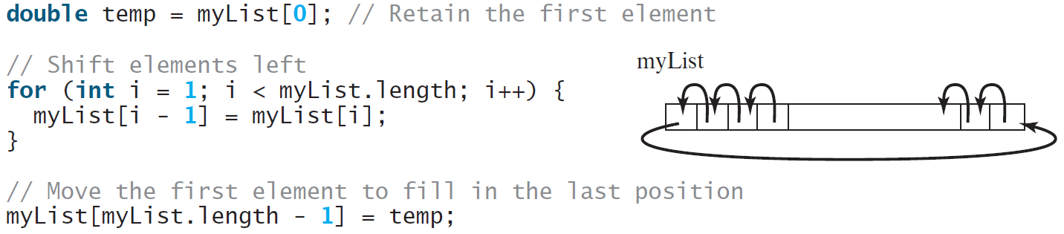
Shifting Elements

Slide 39
Enhanced for Loop (for-each loop)
JDK 1.5 introduced a new for loop that enables you to traverse the complete array sequentially without using an index variable. For example, the following code displays all elements in the array myList:
for (double value: myList)
System.out.println(value);
In general, the syntax is
for (elementType value: arrayRefVar) {
// Process the value
}
You still have to use an index variable if you wish to traverse the array in a different order or change the elements in the array.

Slide 40
☑ Check Point
When is the memory allocated for an array?
What is the output of the following code? int x = 30; int[] numbers = new int[x]; x = 60; System.out.println("x is " + x); System.out.println("The size of numbers is " + numbers.length);
<--- ANSWER --->
The memory is allocated when an array is created.
x is 60 The size of numbers is 30

Slide 41
☑ Check Point
Indicate true or false for the following statements:
(a) Every element in an array has the same type.
(b) The array size is fixed after an array reference variable is declared.
(c) The array size is fixed after it is created.
(d) The elements in an array must be of a primitive data type.
<--- ANSWER --->
(a) True
(b) False
(c) True
(d) False

Slide 42
☑ Check Point
Which of the following statements are valid?
int i = new int(30);
double d[] = new double[30];
char[] r = new char(1..30);
int i[] = (3, 4, 3, 2);
float f[] = {2.3, 4.5, 6.6};
char[] c = new char();
<--- ANSWER --->
Invalid
Valid
Invalid
Invalid
Valid
Invalid

Slide 43
☑ Check Point
How do you access elements in an array?
What is the array index type?
What is the lowest index?
What is the representation of the third element in an array named a?
<--- ANSWER --->
You access an array using its index. arrayRefVar[index] is known as an array indexed variable.
The array index type is int.
Lowest index is 0.
a[2]

Slide 44
☑ Check Point
Write statements to do the following:
(a) Create an array to hold 10 double values.
(b) Assign the value 5.5 to the last element in the array.
(c) Display the sum of the first two elements.
(d) Write a loop that computes the sum of all elements in the array.
(e) Write a loop that finds the minimum element in the array.
(f) Randomly generate an index and display the element of this index in the array.
(g) Use an array initializer to create another array with the initial values 3.5, 5.5, 4.52, and 5.6.
<--- ANSWER --->
(a) double[] list = new double[10];
(b) list[list.length - 1] = 5.5;
(c) System.out.println(list[0] + list[1]);
(d) double sum = 0; for (int i = 0; i < list.length; i++) sum += list[i];
(e) double min = list[0]; for (int i = 1; i < list.length; i++) if (min > list[i]) min = list[i];
(f) System.out.println(list[(int)(Math.random() * list.length)]);
(g) double[] list = {3.5, 5.5, 4.52, 5.6};

Slide 45
☑ Check Point
What happens when your program attempts to access an array element with an invalid index?
Identify and fix the errors in the following code: 1 public class Test { 2 public static void main(String[] args) { 3 double[10] r; 4 5 for (int i = 0; i < r.length(); i++); 6 r(i) = Math.random * 100; 7 } 8 }
<--- ANSWER --->
A runtime exception ArrayIndexOutOfBounds occurs.
Line 3: the array declaration is wrong. It should be double[]. The array needs to be created before it has been used. e.g., new double[10]
Line 5: The semicolon (;) at the end of the for-loop heading should be removed.
Line 5: r.length() should be r.length.
Line 6: random should be random()
Line 6: r(i) should be r[i].

Slide 46
☑ Check Point
What is the output of the following code? 1 public class Test { 2 public static void main(String[] args) { 3 int list[] = {1, 2, 3, 4, 5, 6}; 4 for (int i = 1; i < list.length; i++) 5 list[i] = list[i - 1]; 6 7 for (int i = 0; i < list.length; i++) 8 System.out.print(list[i] + " "); 9 } 10 }
<--- ANSWER --->
1 1 1 1 1 1

Slide 47
Analyze Numbers
Read one hundred numbers, compute their average, and find out how many numbers are above the average.
AnalyzeNumbers
Run

Slide 48
Problem: Deck of Cards
The problem is to write a program that picks four cards randomly from a deck of 52 cards. All the cards can be represented using an array named deck, filled with initial values 0 to 51, as follows:
int[] deck = new int[52];
// Initialize cards
for (int i = 0; i < deck.length; i++)
deck[i] = i;
DeckOfCards
Run

Slide 49
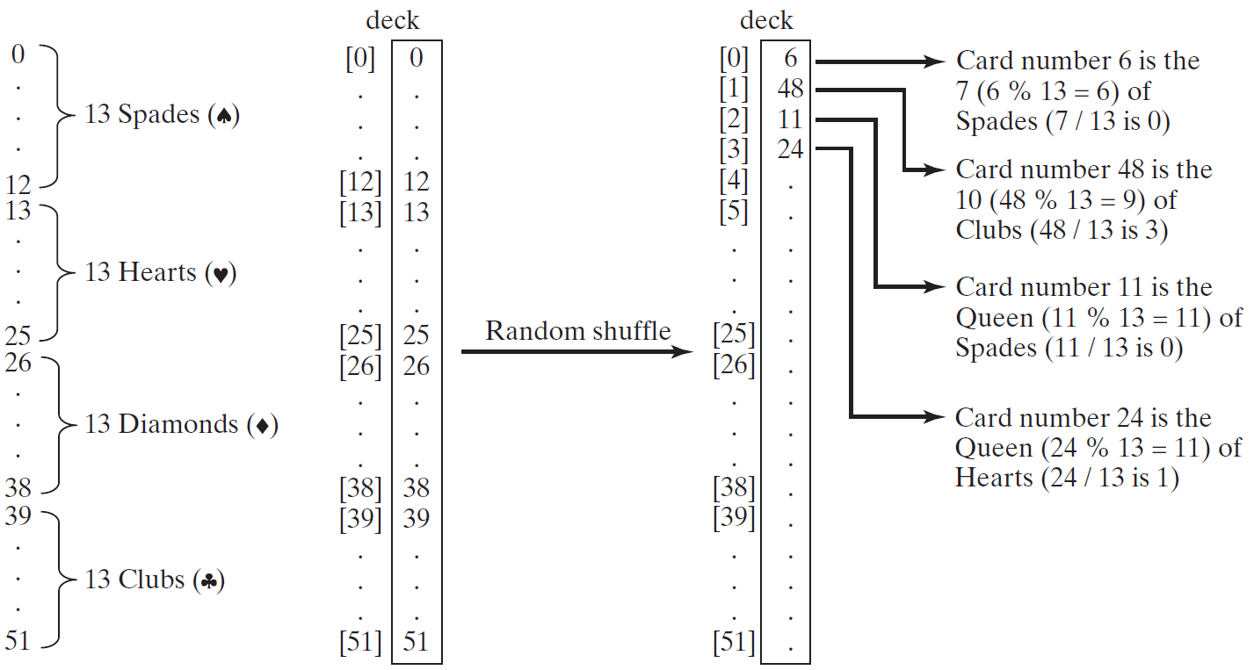
Problem: Deck of Cards, cont.

Slide 50
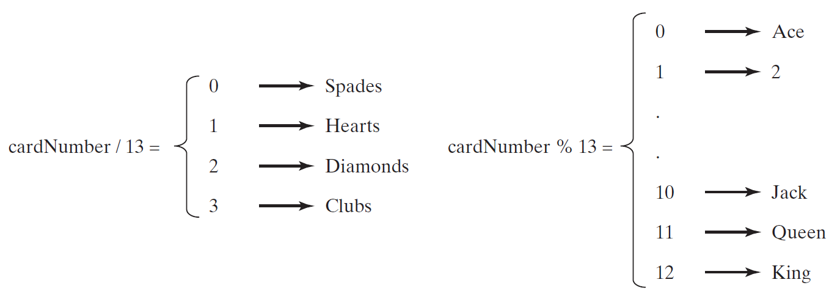
Problem: Deck of Cards, cont.
DeckOfCards
Run

Slide 51
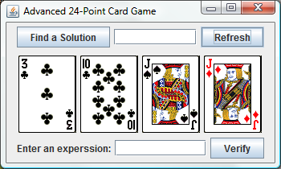
Problem: Deck of Cards
This problem builds a foundation for future more interesting and realistic applications:
See Exercise 20.15.
https://liveexample.pearsoncmg.com/dsanimation/24Point.html

Slide 52
☑ Check Point
1 public class DeckOfCards {
2 public static void main(String[] args) {
3 int[] deck = new int[52];
4 String[] suits = {"Spades", "Hearts", "Diamonds", "Clubs"};
5 String[] ranks = {"Ace", "2", "3", "4", "5", "6", "7", "8", "9",
6 "10", "Jack", "Queen", "King"};
7
8 // Initialize the cards
9 for (int i = 0; i < deck.length; i++)
10 deck[i] = i;
11
12 // Shuffle the cards
13 for (int i = 0; i < deck.length; i++) {
14 // Generate an index randomly
15 int index = (int)(Math.random() * deck.length);
16 int temp = deck[i];
17 deck[i] = deck[index];
18 deck[index] = temp;
19 }
20
21 // Display the first four cards
22 for (int i = 0; i < 4; i++) {
23 String suit = suits[deck[i] / 13];
24 String rank = ranks[deck[i] % 13];
25 System.out.println("Card number " + deck[i] + ": "
26 + rank + " of " + suit);
27 }
28 }
29 }
Will the program pick four random cards if you replace lines 22-27 with the following code? for (int i = 0; i < 4; i++) { int cardNumber = (int)(Math.random() * deck.length); String suit = suits[cardNumber / 13]; String rank = ranks[cardNumber % 13]; System.out.println("Card number " + cardNumber + ": " + rank + " of " + suit); } <--- ANSWER --->
No. You may have the same card appearing more than once.

Slide 53
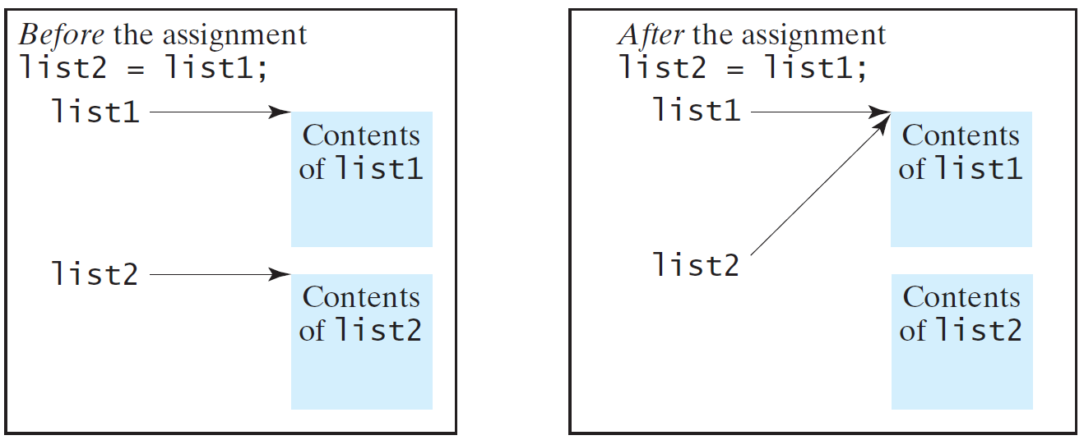
Copying Arrays
Often, in a program, you need to duplicate an array or a part of an array. In such cases you could attempt to use the assignment statement (=), as follows:
list2 = list1;

Slide 54
Copying Arrays
Using a loop:
int[] sourceArray = {2, 3, 1, 5, 10};
int[] targetArray = new int[sourceArray.length];
for (int i = 0; i < sourceArray.length; i++)
targetArray[i] = sourceArray[i];

Slide 55
The arraycopy Utility
arraycopy(sourceArray, src_pos, targetArray, tar_pos, length);
Example:
System.arraycopy(sourceArray, 0, targetArray, 0, sourceArray.length);

Slide 56
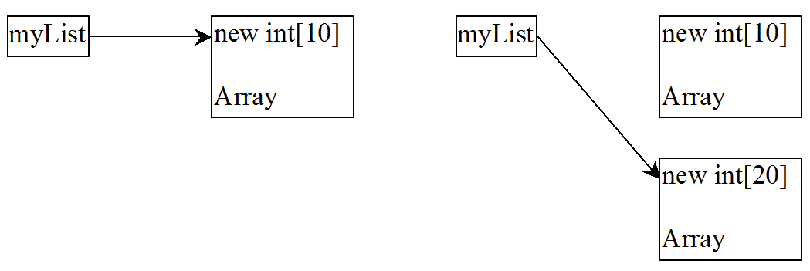
☑ Check Point
Use the arraycopy method to copy the following array to a target array t: int[] source = {3, 4, 5};
Once an array is created, its size cannot be changed. Does the following code resize the array? int[] myList; myList = new int[10]; // Sometime later you want to assign a new array to myList myList = new int[20];
<--- ANSWER --->
System.arraycopy(source, 0, t, 0, source.length);
The second assignment statement myList = new int[20] creates a new array and assigns its reference to myList.

Slide 57
Passing Arrays to Methods
public static void printArray(int[] array) {
for (int i = 0; i < array.length; i++) {
System.out.print(array[i] + " ");
}
}
Invoke the method
int[] list = {3, 1, 2, 6, 4, 2};
printArray(list);
Invoke the method
printArray(new int[]{3, 1, 2, 6, 4, 2});
Anonymous array

Slide 58
Anonymous Array
The statement
printArray(new int[]{3, 1, 2, 6, 4, 2});
creates an array using the following syntax:
new dataType[]{literal0, literal1, ..., literalk};
There is no explicit reference variable for the array. Such array is called an anonymous array.

Slide 59
Pass By Value
Java uses pass by value to pass arguments to a method. There are important differences between passing a value of variables of primitive data types and passing arrays.
For a parameter of a primitive type value, the actual value is passed.
Changing the value of the local parameter inside the method does not affect the value of the variable outside the method.
For a parameter of an array type, the value of the parameter contains a reference to an array; this reference is passed to the method.
Any changes to the array that occur inside the method body will affect the original array that was passed as the argument.

Slide 60
Simple Example
public class Test {
public static void main(String[] args) {
int x = 1; // x represents an int value
int[] y = new int[10]; // y represents an array of int values
m(x, y); // Invoke m with arguments x and y
System.out.println("x is " + x);
System.out.println("y[0] is " + y[0]);
}
public static void m(int number, int[] numbers) {
number = 1001; // Assign a new value to number
numbers[0] = 5555; // Assign a new value to numbers[0]
}
}

Slide 61
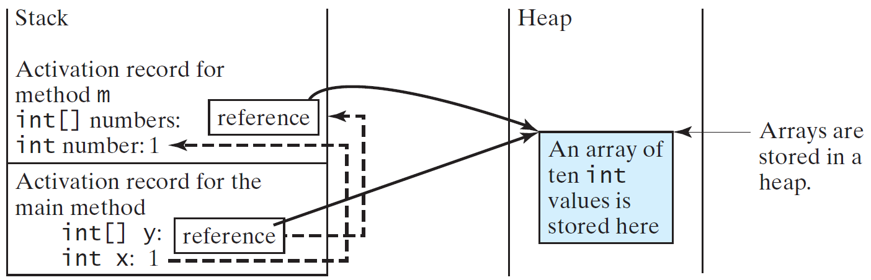
Call Stack
When invoking m(x, y), the values of x and y are passed to number and numbers.
Since y contains the reference value to the array, numbers now contains the same reference value to the same array.

Slide 62
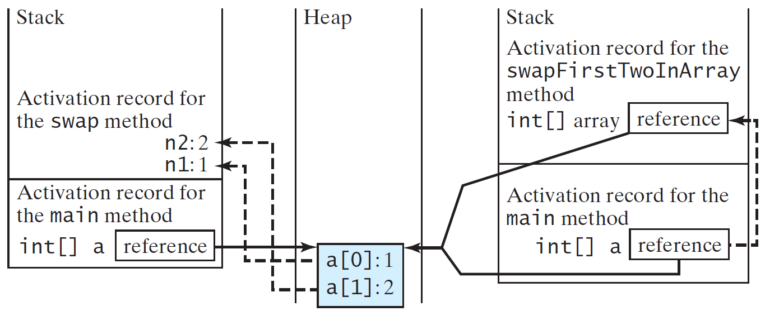
Call Stack
When invoking m(x, y), the values of x and y are passed to number and numbers.
Since y contains the reference value to the array, numbers now contains the same reference value to the same array.

Slide 63
Heap
The JVM stores the array in an area of memory, called heap, which is used for dynamic memory allocation where blocks of memory are allocated and freed in an arbitrary order.

Slide 64
Passing Arrays as Arguments
Objective: Demonstrate differences of passing primitive data type variables and array variables.
TestPassArray
Run

Slide 65
Example, cont.

Slide 66
Returning an Array from a Method
public static int[] reverse(int[] list) {
int[] result = new int[list.length];
for (int i = 0, j = result.length - 1;
i < list.length; i++, j--) {
result[j] = list[i];
}
return result;
}
list
result
int[] list1 = {1, 2, 3, 4, 5, 6};
int[] list2 = reverse(list1);

Slide 67
Trace the reverse Method
animation
int[] list1 = {1, 2, 3, 4, 5, 6};
int[] list2 = reverse(list1);
Declare result and create array
public static int[] reverse(int[] list) {
int[] result = new int[list.length];
for (int i = 0, j = result.length - 1;
i < list.length; i++, j--) {
result[j] = list[i];
}
return result;
}
list
1
2
3
4
5
6
result
0
0
0
0
0
0

Slide 68
Trace the reverse Method, cont.
animation
int[] list1 = {1, 2, 3, 4, 5, 6};
int[] list2 = reverse(list1);
i = 0 and j = 5
public static int[] reverse(int[] list) {
int[] result = new int[list.length];
for (int i = 0, j = result.length - 1;
i < list.length; i++, j--) {
result[j] = list[i];
}
return result;
}
list
1
2
3
4
5
6
result
0
0
0
0
0
0

Slide 69
Trace the reverse Method, cont.
animation
int[] list1 = {1, 2, 3, 4, 5, 6};
int[] list2 = reverse(list1);
i (= 0) is less than 6
public static int[] reverse(int[] list) {
int[] result = new int[list.length];
for (int i = 0, j = result.length - 1;
i < list.length; i++, j--) {
result[j] = list[i];
}
return result;
}
list
1
2
3
4
5
6
result
0
0
0
0
0
0

Slide 70
Trace the reverse Method, cont.
animation
int[] list1 = {1, 2, 3, 4, 5, 6};
int[] list2 = reverse(list1);
i = 0 and j = 5
Assign list[0] to result[5]
public static int[] reverse(int[] list) {
int[] result = new int[list.length];
for (int i = 0, j = result.length - 1;
i < list.length; i++, j--) {
result[j] = list[i];
}
return result;
}
list
1
2
3
4
5
6
result
0
0
0
0
0
1

Slide 71
Trace the reverse Method, cont.
animation
int[] list1 = {1, 2, 3, 4, 5, 6};
int[] list2 = reverse(list1);
After this, i becomes 1 and j becomes 4
public static int[] reverse(int[] list) {
int[] result = new int[list.length];
for (int i = 0, j = result.length - 1;
i < list.length; i++, j--) {
result[j] = list[i];
}
return result;
}
list
1
2
3
4
5
6
result
0
0
0
0
0
1

Slide 72
Trace the reverse Method, cont.
animation
int[] list1 = {1, 2, 3, 4, 5, 6};
int[] list2 = reverse(list1);
i (=1) is less than 6
public static int[] reverse(int[] list) {
int[] result = new int[list.length];
for (int i = 0, j = result.length - 1;
i < list.length; i++, j--) {
result[j] = list[i];
}
return result;
}
list
1
2
3
4
5
6
result
0
0
0
0
0
1

Slide 73
Trace the reverse Method, cont.
animation
int[] list1 = {1, 2, 3, 4, 5, 6};
int[] list2 = reverse(list1);
i = 1 and j = 4
Assign list[1] to result[4]
public static int[] reverse(int[] list) {
int[] result = new int[list.length];
for (int i = 0, j = result.length - 1;
i < list.length; i++, j--) {
result[j] = list[i];
}
return result;
}
list
1
2
3
4
5
6
result
0
0
0
0
2
1

Slide 74
Trace the reverse Method, cont.
animation
int[] list1 = {1, 2, 3, 4, 5, 6};
int[] list2 = reverse(list1);
After this, i becomes 2 and j becomes 3
public static int[] reverse(int[] list) {
int[] result = new int[list.length];
for (int i = 0, j = result.length - 1;
i < list.length; i++, j--) {
result[j] = list[i];
}
return result;
}
list
1
2
3
4
5
6
result
0
0
0
0
2
1

Slide 75
Trace the reverse Method, cont.
animation
int[] list1 = {1, 2, 3, 4, 5, 6};
int[] list2 = reverse(list1);
i (=2) is still less than 6
public static int[] reverse(int[] list) {
int[] result = new int[list.length];
for (int i = 0, j = result.length - 1;
i < list.length; i++, j--) {
result[j] = list[i];
}
return result;
}
list
1
2
3
4
5
6
result
0
0
0
0
2
1

Slide 76
Trace the reverse Method, cont.
animation
int[] list1 = {1, 2, 3, 4, 5, 6};
int[] list2 = reverse(list1);
i = 2 and j = 3
Assign list[i] to result[j]
public static int[] reverse(int[] list) {
int[] result = new int[list.length];
for (int i = 0, j = result.length - 1;
i < list.length; i++, j--) {
result[j] = list[i];
}
return result;
}
list
1
2
3
4
5
6
result
0
0
0
3
2
1

Slide 77
Trace the reverse Method, cont.
animation
int[] list1 = {1, 2, 3, 4, 5, 6};
int[] list2 = reverse(list1);
After this, i becomes 3 and j becomes 2
public static int[] reverse(int[] list) {
int[] result = new int[list.length];
for (int i = 0, j = result.length - 1;
i < list.length; i++, j--) {
result[j] = list[i];
}
return result;
}
list
1
2
3
4
5
6
result
0
0
0
3
2
1

Slide 78
Trace the reverse Method, cont.
animation
int[] list1 = {1, 2, 3, 4, 5, 6};
int[] list2 = reverse(list1);
i (=3) is still less than 6
public static int[] reverse(int[] list) {
int[] result = new int[list.length];
for (int i = 0, j = result.length - 1;
i < list.length; i++, j--) {
result[j] = list[i];
}
return result;
}
list
1
2
3
4
5
6
result
0
0
0
3
2
1

Slide 79
Trace the reverse Method, cont.
animation
int[] list1 = {1, 2, 3, 4, 5, 6};
int[] list2 = reverse(list1);
i = 3 and j = 2
Assign list[i] to result[j]
public static int[] reverse(int[] list) {
int[] result = new int[list.length];
for (int i = 0, j = result.length - 1;
i < list.length; i++, j--) {
result[j] = list[i];
}
return result;
}
list
1
2
3
4
5
6
result
0
0
4
3
2
1

Slide 80
Trace the reverse Method, cont.
animation
int[] list1 = {1, 2, 3, 4, 5, 6};
int[] list2 = reverse(list1);
After this, i becomes 4 and j becomes 1
public static int[] reverse(int[] list) {
int[] result = new int[list.length];
for (int i = 0, j = result.length - 1;
i < list.length; i++, j--) {
result[j] = list[i];
}
return result;
}
list
1
2
3
4
5
6
result
0
0
4
3
2
1

Slide 81
Trace the reverse Method, cont.
animation
int[] list1 = {1, 2, 3, 4, 5, 6};
int[] list2 = reverse(list1);
i (=4) is still less than 6
public static int[] reverse(int[] list) {
int[] result = new int[list.length];
for (int i = 0, j = result.length - 1;
i < list.length; i++, j--) {
result[j] = list[i];
}
return result;
}
list
1
2
3
4
5
6
result
0
0
4
3
2
1

Slide 82
Trace the reverse Method, cont.
animation
int[] list1 = {1, 2, 3, 4, 5, 6};
int[] list2 = reverse(list1);
i = 4 and j = 1
Assign list[i] to result[j]
public static int[] reverse(int[] list) {
int[] result = new int[list.length];
for (int i = 0, j = result.length - 1;
i < list.length; i++, j--) {
result[j] = list[i];
}
return result;
}
list
1
2
3
4
5
6
result
0
5
4
3
2
1

Slide 83
Trace the reverse Method, cont.
animation
int[] list1 = {1, 2, 3, 4, 5, 6};
int[] list2 = reverse(list1);
After this, i becomes 5 and j becomes 0
public static int[] reverse(int[] list) {
int[] result = new int[list.length];
for (int i = 0, j = result.length - 1;
i < list.length; i++, j--) {
result[j] = list[i];
}
return result;
}
list
1
2
3
4
5
6
result
0
5
4
3
2
1

Slide 84
Trace the reverse Method, cont.
animation
int[] list1 = {1, 2, 3, 4, 5, 6};
int[] list2 = reverse(list1);
i (=5) is still less than 6
public static int[] reverse(int[] list) {
int[] result = new int[list.length];
for (int i = 0, j = result.length - 1;
i < list.length; i++, j--) {
result[j] = list[i];
}
return result;
}
list
1
2
3
4
5
6
result
0
5
4
3
2
1

Slide 85
Trace the reverse Method, cont.
animation
int[] list1 = {1, 2, 3, 4, 5, 6};
int[] list2 = reverse(list1);
i = 5 and j = 0
Assign list[i] to result[j]
public static int[] reverse(int[] list) {
int[] result = new int[list.length];
for (int i = 0, j = result.length - 1;
i < list.length; i++, j--) {
result[j] = list[i];
}
return result;
}
list
1
2
3
4
5
6
result
6
5
4
3
2
1

Slide 86
Trace the reverse Method, cont.
animation
int[] list1 = {1, 2, 3, 4, 5, 6};
int[] list2 = reverse(list1);
After this, i becomes 6 and j becomes -1
public static int[] reverse(int[] list) {
int[] result = new int[list.length];
for (int i = 0, j = result.length - 1;
i < list.length; i++, j--) {
result[j] = list[i];
}
return result;
}
list
1
2
3
4
5
6
result
6
5
4
3
2
1

Slide 87
Trace the reverse Method, cont.
animation
int[] list1 = {1, 2, 3, 4, 5, 6};
int[] list2 = reverse(list1);
i (=6) < 6 is false. So exit the loop.
public static int[] reverse(int[] list) {
int[] result = new int[list.length];
for (int i = 0, j = result.length - 1;
i < list.length; i++, j--) {
result[j] = list[i];
}
return result;
}
list
1
2
3
4
5
6
result
6
5
4
3
2
1

Slide 88
Trace the reverse Method, cont.
animation
int[] list1 = {1, 2, 3, 4, 5, 6};
int[] list2 = reverse(list1);
Return result
public static int[] reverse(int[] list) {
int[] result = new int[list.length];
for (int i = 0, j = result.length - 1;
i < list.length; i++, j--) {
result[j] = list[i];
}
return result;
}
list
1
2
3
4
5
6
list2
result
6
5
4
3
2
1

Slide 89
☑ Check Point
Suppose the following code is written to reverse the contents in an array, explain why it is wrong. How do you fix it? int[] list = {1, 2, 3, 5, 4}; for (int i = 0, j = list.length - 1; i < list.length; i++, j--) { // Swap list[i] with list[j] int temp = list[i]; list[i] = list[j]; list[j] = temp; }
<--- ANSWER --->
It swaps the elements twice. For example, the first element is swapped with the last element once and then the last element is swapped with the first element another time. In effect, the elements are not swapped. Here is the fix: int[] list = {1, 2, 3, 5, 4}; for (int i = 0, j = list.length - 1; i < list.length / 2; i++, j--) { // Swap list[i] with list[j] int temp = list[i]; list[i] = list[j]; list[j] = temp; }

Slide 90
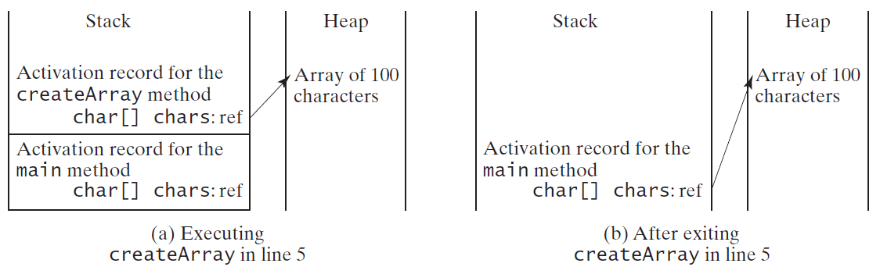
Problem: Counting Occurrence of Each Letter
Generate 100 lowercase letters randomly and assign to an array of characters.
Count the occurrence of each letter in the array.
CountLettersInArray
Run

Slide 91
☑ Check Point
True or false? When an array is passed to a method, a new array is created and passed to the method.
<--- ANSWER --->
False. When an array is passed to a method, the reference value of the array is passed. No new array is created. Both argument and parameter point to the same array.

Slide 92
☑ Check Point
Show the output of the following program: public class Test { public static void main(String[] args) { int number = 0; int[] numbers = new int[1]; m(number, numbers); System.out.println("number is " + number + " and numbers[0] is " + numbers[0]); } public static void m(int x, int[] y) { x = 3; y[0] = 3; } }
<--- ANSWER --->
number is 0 and numbers[0] is 3

Slide 93
☑ Check Point
Show the output of the following program: public class Test { public static void main(String[] args) { int[] list = {1, 2, 3, 4, 5}; reverse(list); for (int i = 0; i < list.length; i++) System.out.print(list[i] + " "); } public static void reverse(int[] list) { int[] newList = new int[list.length]; for (int i = 0; i < list.length; i++) newList[i] = list[list.length - 1 - i]; list = newList; } }
<--- ANSWER --->
1 2 3 4 5

Slide 94
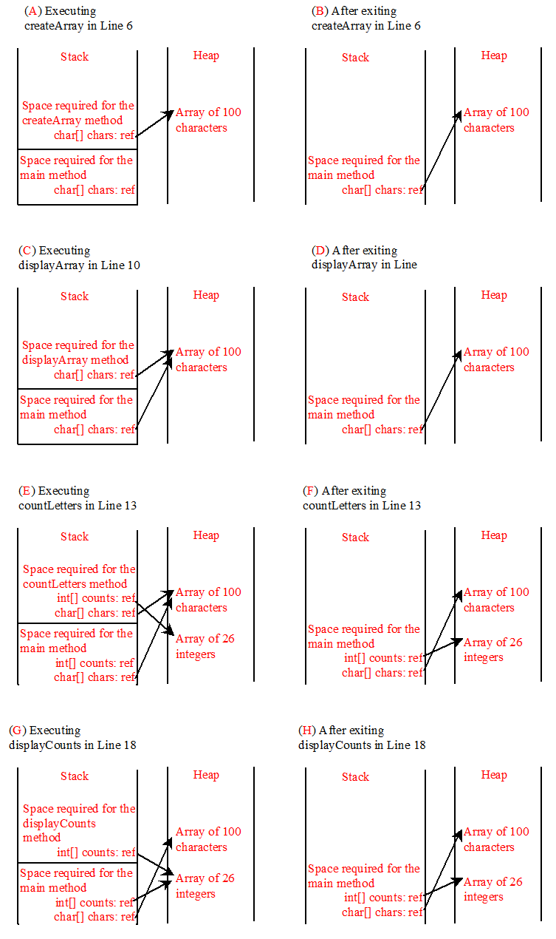
☑ Check Point
Where are the arrays stored during execution? Show the contents of the stack and heap during and after executing displayArray, countLetters, displayCounts in Listing 7.4.
<--- ANSWER --->

Slide 95
Variable-Length Arguments
You can pass a variable number of arguments of the same type to a method.
In the method declaration, you specify the type followed by an ellipsis (...).
Only one variable-length parameter may be specified in a method.
This parameter must be the last parameter. Any regular parameters must precede it.
VarArgsDemo
Run

Slide 96
☑ Check Point
What is wrong with each of the following method headers? public static void print(String... strings, double... numbers) public static void print(double... numbers, String name) public static double... print(double d1, double d2)
<--- ANSWER --->
Only one variable-length parameter may be specified in a method. This parameter must be the last parameter. The method return type cannot be a variable-length parameter.

Slide 97
☑ Check Point
1 public class VarArgsDemo {
2 public static void main(String[] args) {
3 printMax(34, 3, 3, 2, 56.5);
4 printMax(new double[]{1, 2, 3});
5 }
6
7 public static void printMax(double... numbers) {
8 if (numbers.length == 0) {
9 System.out.println("No argument passed");
10 return;
11 }
12
13 double result = numbers[0];
14
15 for (int i = 1; i < numbers.length; i++)
16 if (numbers[i] > result)
17 result = numbers[i];
18
19 System.out.println("The max value is " + result);
20 }
21 }
Can you invoke the printMax method using the following statements? printMax(1, 2, 2, 1, 4); printMax(new double[]{1, 2, 3}); printMax(new int[]{1, 2, 3});
<--- ANSWER --->
The last one printMax(new int[]{1, 2, 3}); is incorrect, because the array must of the double[] type.

Slide 98
Searching Arrays
Searching is the process of looking for a specific element in an array; for example, discovering whether a certain score is included in a list of scores.
Searching is a common task in computer programming.
There are many algorithms and data structures devoted to searching.
In this section, two commonly used approaches are discussed, linear search and binary search.

Slide 99
Linear Search
The linear search approach compares the key element, key, sequentially with each element in the array list.
The method continues to do so until the key matches an element in the list or the list is exhausted without a match being found.
If a match is made, the linear search returns the index of the element in the array that matches the key.
If no match is found, the search returns -1.

Slide 100
Linear Search Animation
animation
Key
List
3
6 | 4 | 1 | 9 | 7 | 3 | 2 | 8
3
6 | 4 | 1 | 9 | 7 | 3 | 2 | 8
3
6 | 4 | 1 | 9 | 7 | 3 | 2 | 8
3
6 | 4 | 1 | 9 | 7 | 3 | 2 | 8
3
6 | 4 | 1 | 9 | 7 | 3 | 2 | 8
3
6 | 4 | 1 | 9 | 7 | 3 | 2 | 8

Slide 101
Linear Search Animation
animation
https://liveexample.pearsoncmg.com/dsanimation/LinearSearcheBook.html

Slide 102
From Idea to Solution
/** The method for finding a key in the list */
public static int linearSearch(int[] list, int key) {
for (int i = 0; i < list.length; i++)
if (key == list[i])
return i;
return -1;
}
Trace the method
int[] list = {1, 4, 4, 2, 5, -3, 6, 2};
int i = linearSearch(list, 4); // returns 1
int j = linearSearch(list, -4); // returns -1
int k = linearSearch(list, -3); // returns 5

Slide 103
Binary Search
For binary search to work, the elements in the array must already be ordered. Without loss of generality, assume that the array is in ascending order.
e.g., 2 4 7 10 11 45 50 59 60 66 69 70 79
The binary search first compares the key with the element in the middle of the array.

Slide 104
Binary Search, cont.
Consider the following three cases:
If the key is less than the middle element, you only need to search the key in the first half of the array.
If the key is equal to the middle element, the search ends with a match.
If the key is greater than the middle element, you only need to search the key in the second half of the array.

Slide 105
Binary Search
animation
Key
List
8
1 | 2 | 3 | 4 | 6 | 7 | 8 | 9
8
1 | 2 | 3 | 4 | 6 | 7 | 8 | 9
8
1 | 2 | 3 | 4 | 6 | 7 | 8 | 9

Slide 106
Binary Search Animation
animation
https://liveexample.pearsoncmg.com/dsanimation/BinarySearcheBook.html

Slide 107
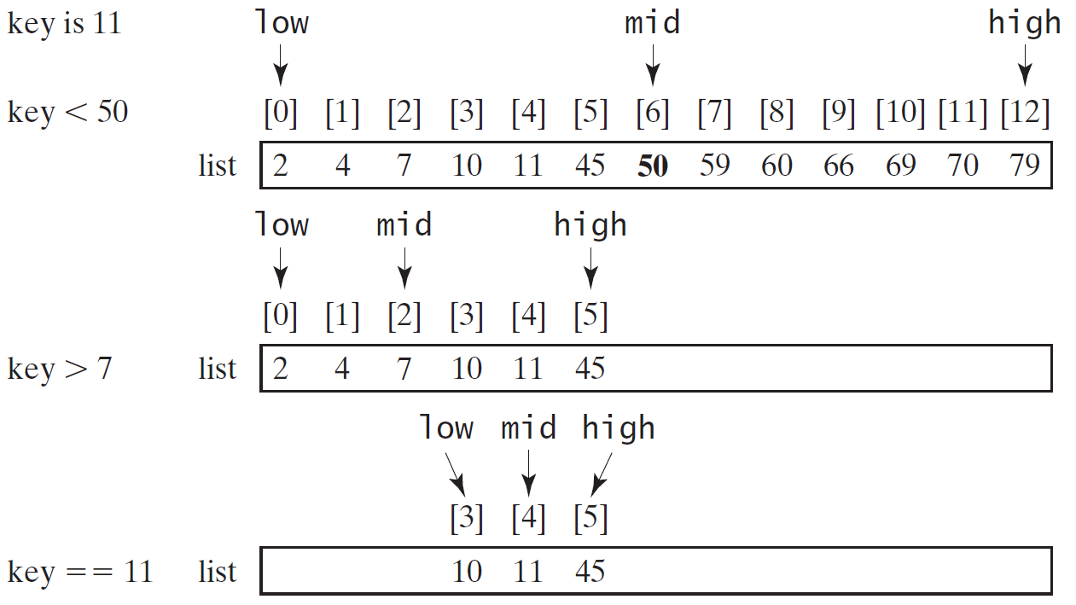
Binary Search, cont.

Slide 108
Binary Search, cont.

Slide 109
Binary Search, cont.
The binarySearch method returns the index of the element in the list that matches the search key if it is contained in the list. Otherwise, it returns
- insertion point - 1.
The insertion point is the point at which the key would be inserted into the list.

Slide 110
From Idea to Soluton
/** Use binary search to find the key in the list */
public static int binarySearch(int[] list, int key) {
int low = 0;
int high = list.length - 1;
while (high >= low) {
int mid = (low + high) / 2;
if (key < list[mid])
high = mid - 1;
else if (key == list[mid])
return mid;
else
low = mid + 1;
}
return -1 - low;
}

Slide 111
The Arrays.binarySearch Method
Since binary search is frequently used in programming, Java provides several overloaded binarySearch methods for searching a key in an array of int, double, char, short, long, and float in the java.util.Arrays class. For example, the following code searches the keys in an array of numbers and an array of characters.
int[] list = {2, 4, 7, 10, 11, 45, 50, 59, 60, 66, 69, 70, 79};
System.out.println("Index is " +
java.util.Arrays.binarySearch(list, 11));
char[] chars = {'a', 'c', 'g', 'x', 'y', 'z'};
System.out.println("Index is " +
java.util.Arrays.binarySearch(chars, 't'));
For the binarySearch method to work, the array must be pre-sorted in increasing order.
Return is 4
Return is –4 (insertion point is 3, so return is -3-1)

Slide 112
☑ Check Point
1 public class BinarySearch {
2 /** Use binary search to find the key in the list */
3 public static int binarySearch(int[] list, int key) {
4 int low = 0;
5 int high = list.length - 1;
6
7 while (high >= low) {
8 int mid = (low + high) / 2;
9 if (key < list[mid])
10 high = mid - 1;
11 else if (key == list[mid])
12 return mid;
13 else
14 low = mid + 1;
15 }
16
17 return –low - 1; // Now high < low, key not found
18 }
19 }
If high is a very large integer such as the maximum int value 2147483647, (low + high) / 2 may cause overflow. How do you fix it to avoid overflow?
Show how to apply the binary search approach to a search for key 10 and key 12 in list {2, 4, 7, 10, 11, 45, 50, 59, 60, 66, 69, 70, 79}.
If the binary search method returns -4, is the key in the list? Where should the key be inserted if you wish to insert the key into the list?
<--- ANSWER --->
Replace (low + high) / 2 with (-low + high) / 2 + low
Try on Figure 7.9 on the textbook, page 267.
The key is not in the list. The key should be inserted at -(-4 + 1) = 3.

Slide 113
Sorting Arrays
Sorting, like searching, is also a common task in computer programming.
Many different algorithms have been developed for sorting.
This section introduces a simple, intuitive sorting algorithms: selection sort.

Slide 114
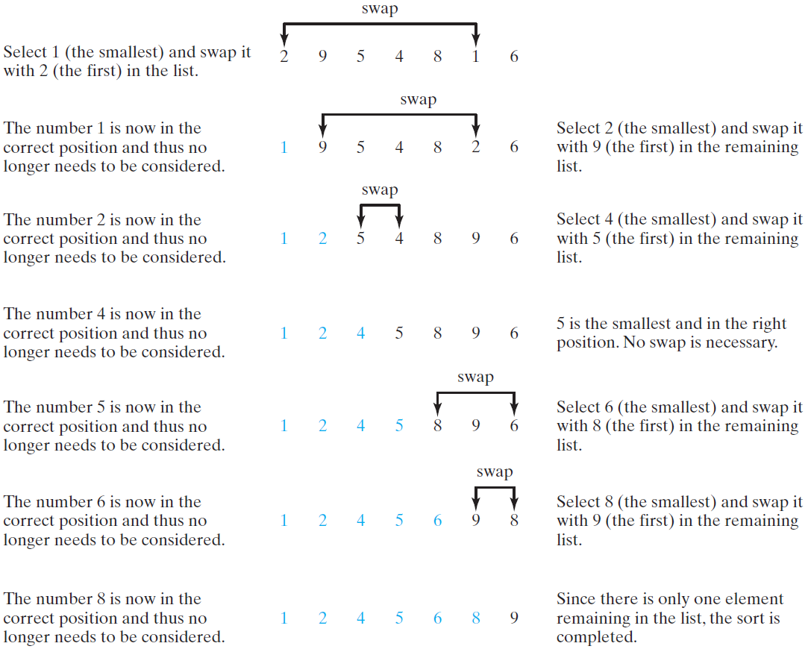
Selection Sort
Selection sort finds the smallest number in the list and places it first. It then finds the smallest number remaining and places it second, and so on until the list contains only a single number.

Slide 115
Selection Sort Animation
animation
https://liveexample.pearsoncmg.com/dsanimation/SelectionSortNew.html

Slide 116
From Idea to Solution
for (int i = 0; i < list.length; i++) {
select the smallest element in list[i..listSize-1];
swap the smallest with list[i], if necessary;
// list[i] is in its correct position.
// The next iteration apply on list[i+1..listSize-1]
}
list[0] list[1] list[2] list[3] ... list[10]
list[0] list[1] list[2] list[3] ... list[10]
list[0] list[1] list[2] list[3] ... list[10]
list[0] list[1] list[2] list[3] ... list[10]
list[0] list[1] list[2] list[3] ... list[10]
...
list[0] list[1] list[2] list[3] ... list[10]

Slide 117
Expand
for (int i = 0; i < listSize; i++) {
select the smallest element in list[i..listSize-1];
swap the smallest with list[i], if necessary;
// list[i] is in its correct position.
// The next iteration apply on list[i..listSize-1]
}
double currentMin = list[i];
int currentMinIndex = i;
for (int j = i+1; j < list.length; j++) {
if (currentMin > list[j]) {
currentMin = list[j];
currentMinIndex = j;
}
}

Slide 118
Expand
for (int i = 0; i < listSize; i++) {
select the smallest element in list[i..listSize-1];
swap the smallest with list[i], if necessary;
// list[i] is in its correct position.
// The next iteration apply on list[i..listSize-1]
}
double currentMin = list[i];
int currentMinIndex = i;
for (int j = i; j < list.length; j++) {
if (currentMin > list[j]) {
currentMin = list[j];
currentMinIndex = j;
}
}

Slide 119
Expand
for (int i = 0; i < listSize; i++) {
select the smallest element in list[i..listSize-1];
swap the smallest with list[i], if necessary;
// list[i] is in its correct position.
// The next iteration apply on list[i..listSize-1]
}
if (currentMinIndex != i) {
list[currentMinIndex] = list[i];
list[i] = currentMin;
}

Slide 120
Wrap it in a Method
/** The method for sorting the numbers */
public static void selectionSort(double[] list) {
for (int i = 0; i < list.length; i++) {
// Find the minimum in the list[i..list.length-1]
double currentMin = list[i];
int currentMinIndex = i;
for (int j = i + 1; j < list.length; j++) {
if (currentMin > list[j]) {
currentMin = list[j];
currentMinIndex = j;
}
}
// Swap list[i] with list[currentMinIndex] if necessary;
if (currentMinIndex != i) {
list[currentMinIndex] = list[i];
list[i] = currentMin;
}
}
}
Invoke it
selectionSort(yourList)

Slide 121
☑ Check Point
1 public class SelectionSort {
2 /** The method for sorting the numbers */
3 public static void selectionSort(double[] list) {
4 for (int i = 0; i < list.length - 1; i++) {
5 // Find the minimum in the list[i..list.length-1]
6 double currentMin = list[i];
7 int currentMinIndex = i;
8
9 for (int j = i + 1; j < list.length; j++) {
10 if (currentMin > list[j]) {
11 currentMin = list[j];
12 currentMinIndex = j;
13 }
14 }
15
16 // Swap list[i] with list[currentMinIndex] if necessary
17 if (currentMinIndex != i) {
18 list[currentMinIndex] = list[i];
19 list[i] = currentMin;
20 }
21 }
22 }
23 }
Show how to apply the selection-sort approach to sort {3.4, 5, 3, 3.5, 2.2, 1.9, 2}.
How do you modify the selectionSort method to sort numbers in decreasing order?
<--- ANSWER --->
Try on Figure 7.11 on the textbook, page 269.
Left as an exercise for students.

Slide 122
The Arrays.sort Method
Since sorting is frequently used in programming, Java provides several overloaded sort methods for sorting an array of int, double, char, short, long, and float in the java.util.Arrays class. For example, the following code sorts an array of numbers and an array of characters.
double[] numbers = {6.0, 4.4, 1.9, 2.9, 3.4, 3.5};
java.util.Arrays.sort(numbers);
char[] chars = {'a', 'A', '4', 'F', 'D', 'P'};
java.util.Arrays.sort(chars);
Java 8 now provides Arrays.parallelSort(list) that utilizes the multicore for fast sorting.

Slide 123
The Arrays.toString(list) Method
The Arrays.toString(list) method can be used to return a string representation for the list.

Slide 124
☑ Check Point
What types of array can be sorted using the java.util.Arrays.sort method?
Does this sort method create a new array?
To apply java.util.Arrays.binarySearch(array, key), should the array be sorted in increasing order, in decreasing order, or neither?
<--- ANSWER --->
You can sort an array of any primitive types except boolean.
The sort method is void, so it does not return a new array.
To apply java.util.Arrays.binarySearch(array, key), the array must be sorted in increasing order.

Slide 125
☑ Check Point
Show the output of the following code: int[] list1 = {2, 4, 7, 10}; java.util.Arrays.fill(list1, 7); System.out.println(java.util.Arrays.toString(list1)); int[] list2 = {2, 4, 7, 10}; System.out.println(java.util.Arrays.toString(list2)); System.out.print(java.util.Arrays.equals(list1, list2));
<--- ANSWER --->
[7, 7, 7, 7] [2, 4, 7, 10] False

Slide 126
Pass Arguments to Invoke the Main Method

Slide 127
Main Method Is Just a Regular Method
You can call a regular method by passing actual parameters.
Can you pass arguments to main? Of course, yes.
For example, the main method in class B is invoked by a method in A, as shown below:

Slide 128
Command-Line Parameters
class TestMain {
public static void main(String[] args) {
...
}
}
java TestMain arg0 arg1 arg2 ... argn

Slide 129
Processing Command-Line Parameters
In the main method, get the arguments from args[0], args[1], ..., args[n],
which corresponds to arg0, arg1, ..., argn in the command line.
Notes:
Example 12.4

Slide 130
Problem: Calculator
Objective: Write a program that will perform binary operations on integers. The program receives three parameters: an operator and two integers.
java Calculator 2 + 3
java Calculator 2 - 3
Calculator
java Calculator 2 / 3
Run
java Calculator 2 . 3

Slide 131
☑ Check Point
The textbook declares the main method as public static void main(String[] args)
Can it be replaced by one of the following lines? (a) public static void main(String args[])
(b) public static void main(String[] x)
(c) public static void main(String x[])
(d) static void main(String x[])
<--- ANSWER --->
(a) Yes.
(b) Yes.
(c) Yes.
(d) No, because it is not public.

Slide 132
☑ Check Point
public class Test { public static void main(String[] args) { System.out.println("Number of strings is " + args.length); for (int i = 0; i < args.length; i++) System.out.println(args[i]); } }
Show the output of the program above, when invoked using the following:
1. java Test I have a dream
2. java Test "1 2 3"
3. java Test
<--- ANSWER --->
(1) Number of strings is 4 I have a dream
(2) Number of strings is 1 1 2 3
(3) Number of strings is 0

